Slide 1
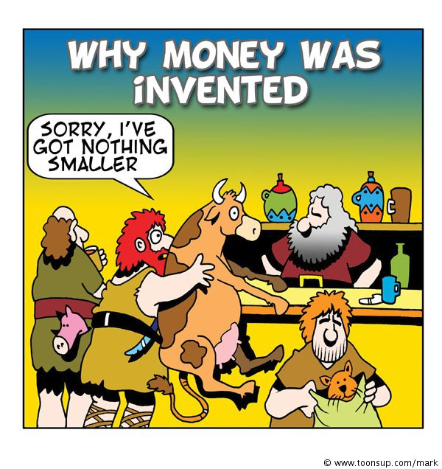

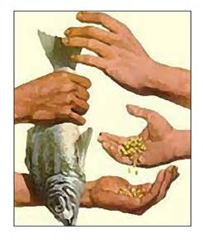

Arguments for BARTER

Slide 2

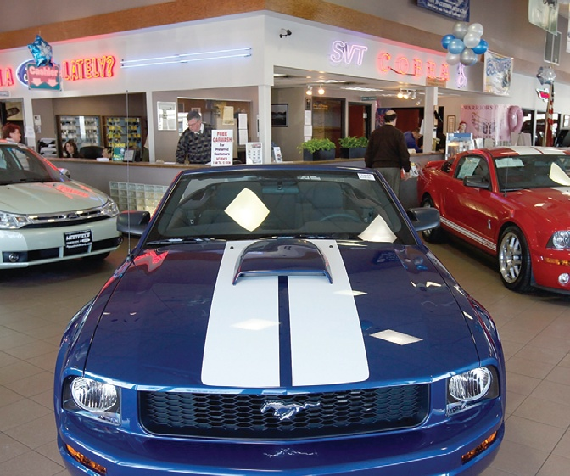

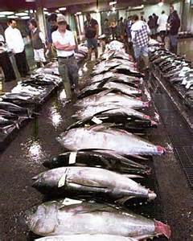
Auction
Auction has been used to trade antiques and fine arts to the stock exchanges and government purchases.
Auction, in Latin, means “to increase”. What auction that you have experienced or familiar with?

Slide 3
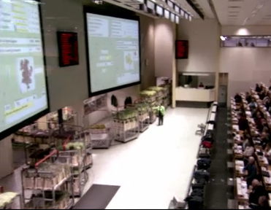
Take a look…
For a look at a real-world equilibrium, click the picture below to see the Aalsmeer Dutch Tulip auction in action. (3 minutes)
Notes:
http://video.kera.org/video/1283843915/

Slide 4
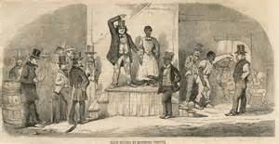

Slave Auction, Tulip Mania

Slide 5

AUCTION S
The types of Auctions:
English Auction
Dutch Auction
Sealed-Bid (Silent) Auction
Vickrey Auction
Winner’s Curse
To First
Active Learning
To Video

Slide 6
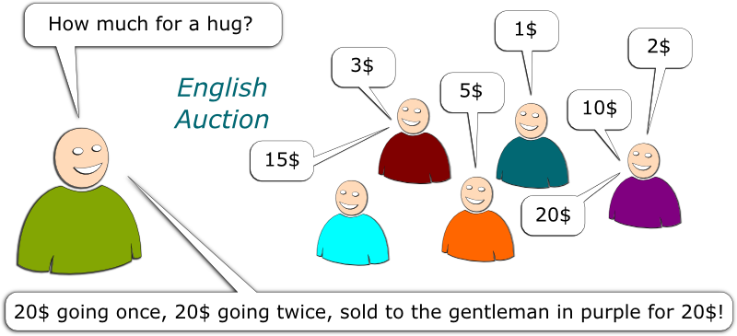
English Auction
Commonly used for selling antiques, arts, cattle, used cars.
Bids increase until no one is willing to top the current bid.

Slide 7
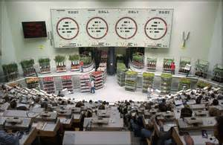
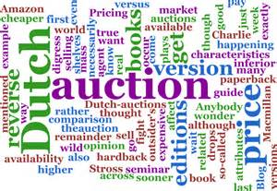
Dutch Auction
The Dutch auction is like an English auction, except that prices start high and are successively dropped until a bidder accepts the going price, at which point the auction ends.
The Dutch auction is so-named because it is used to sell cut ﬂowers in Holland.

Slide 8
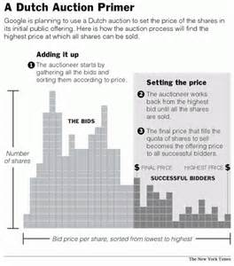
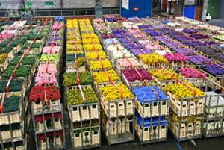
Dutch Auction

Slide 9

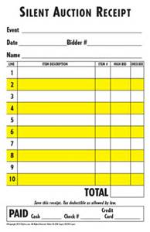
Sealed Bid Auction
In a sealed-bid auction, bids are opened simultaneously, and the highest bidder wins the item and pays his bid.
The analysis of the sealed-bid auction is more challenging because the bidders don’t have a dominant strategy.

Slide 10
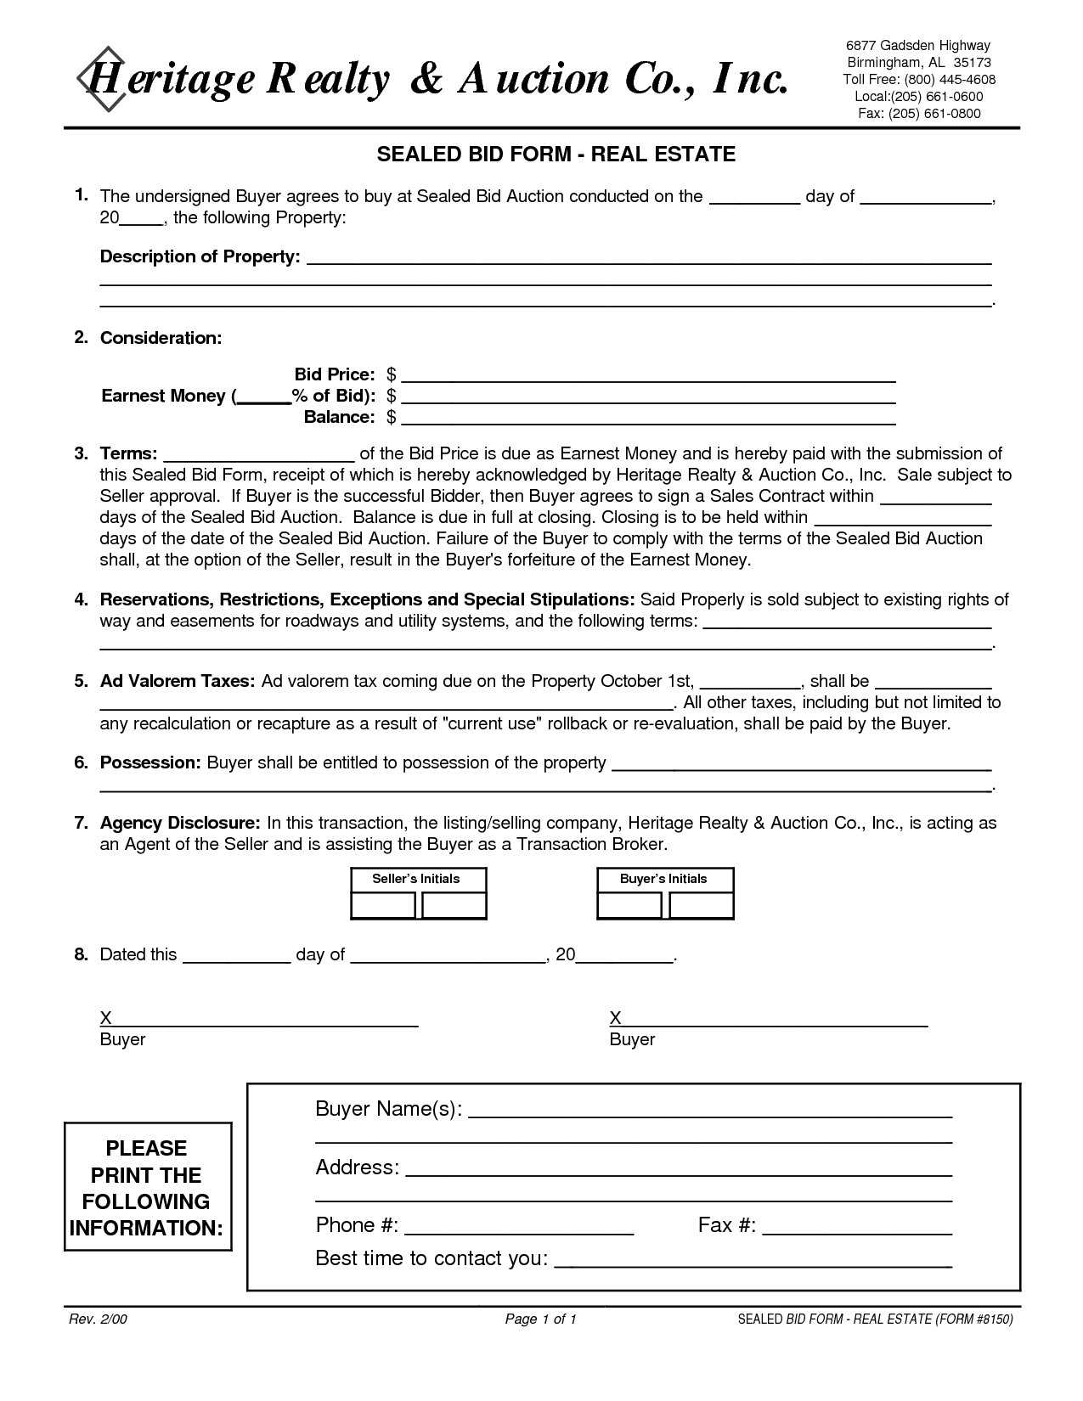
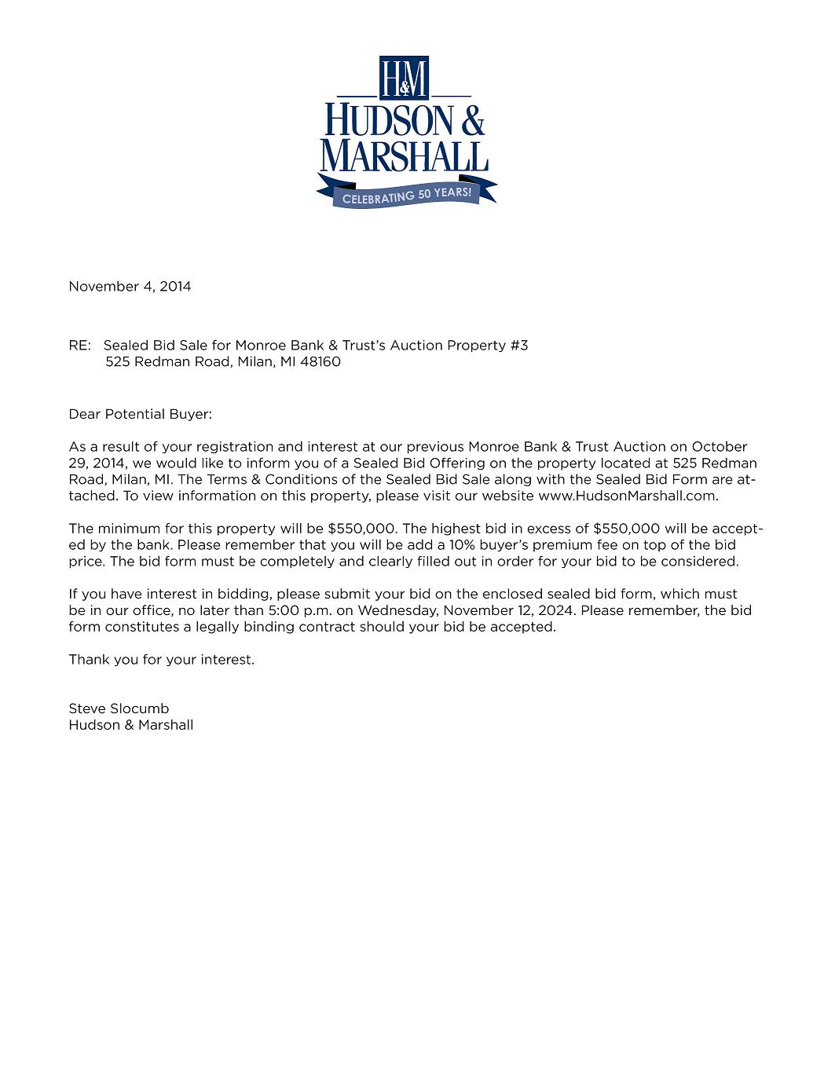
Sealed Bid Auction

Slide 11
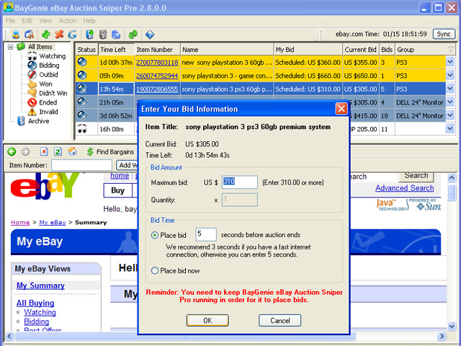

Vickrey Auction
The Vickrey Auction is a sealed-bid auction where the high bidder wins but pays the second-highest bid. It’s is also called a second-price auction: the price is not the highest bid but the second-highest bid.
The Vickrey auction underlies eBay because when a bidder submits a bid in the eBay auction, the current “going” price is not the highest bid, but the second-highest bid plus a bid increment. Thus, up to the granularity of the bid increment, the basic eBay auction is a Vickrey auction run over time.

Slide 12
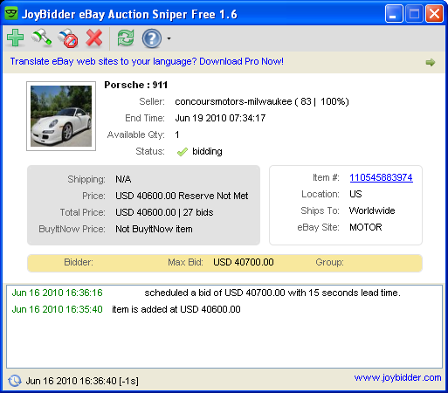
ebay Porsche

Slide 13

Winner’s Curse
I paid too much for it, but it's worth it.
Auctions, by their nature, select optimistic bidders.
This phenomenon—that auctions tend to select the bidder with the highest estimate, and the highest estimate is larger than the true value most of the time—is known as the winner’s curse.
A savvy bidder corrects for the winner’s curse.

